Slide 1

Service Management of Campus Card
Group 5 Progress Report
Members：Wang Jianing (Physics)
Yu Huacheng (Chemistry)
Sun Haokun (Biology)

Slide 2
Four questions
User interface
User interface
how our interface can user-friendly?
Algorithm
Which algorithm fit our systems’ need?
Dive in
What can we learn from a campus card system?
Inspiration
How does our campus cards system work?

Slide 3
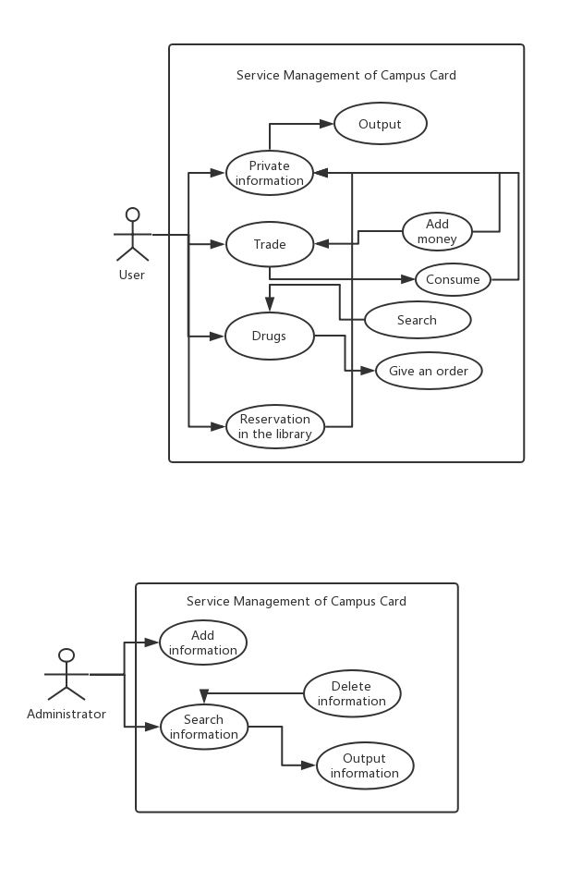
Two classifications

Slide 4
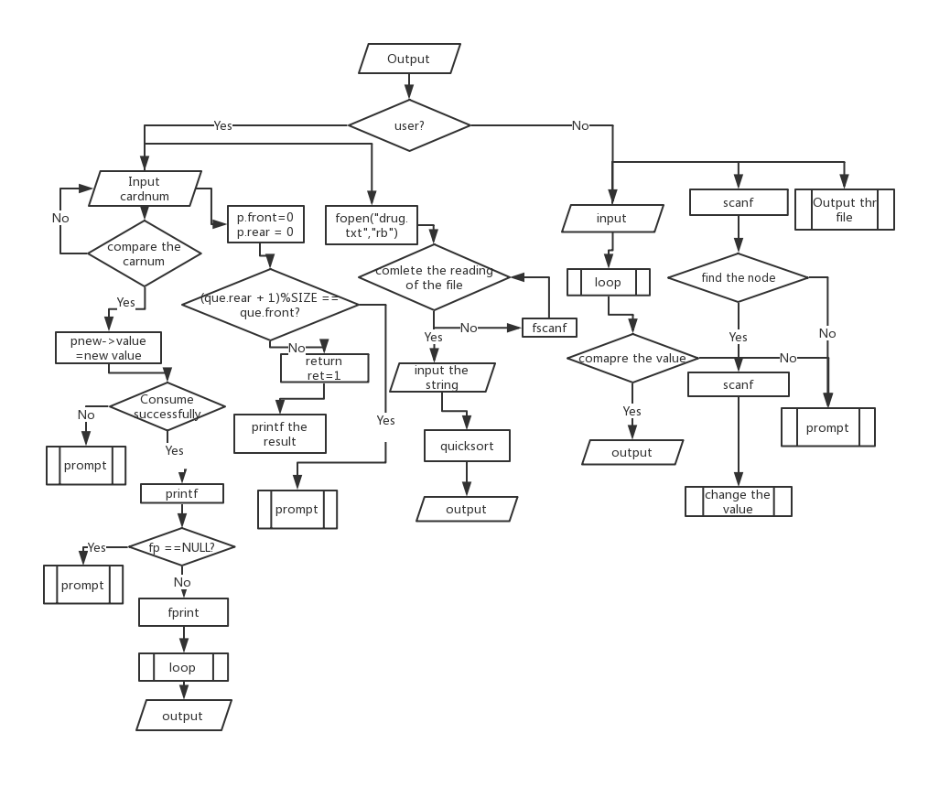

Slide 5
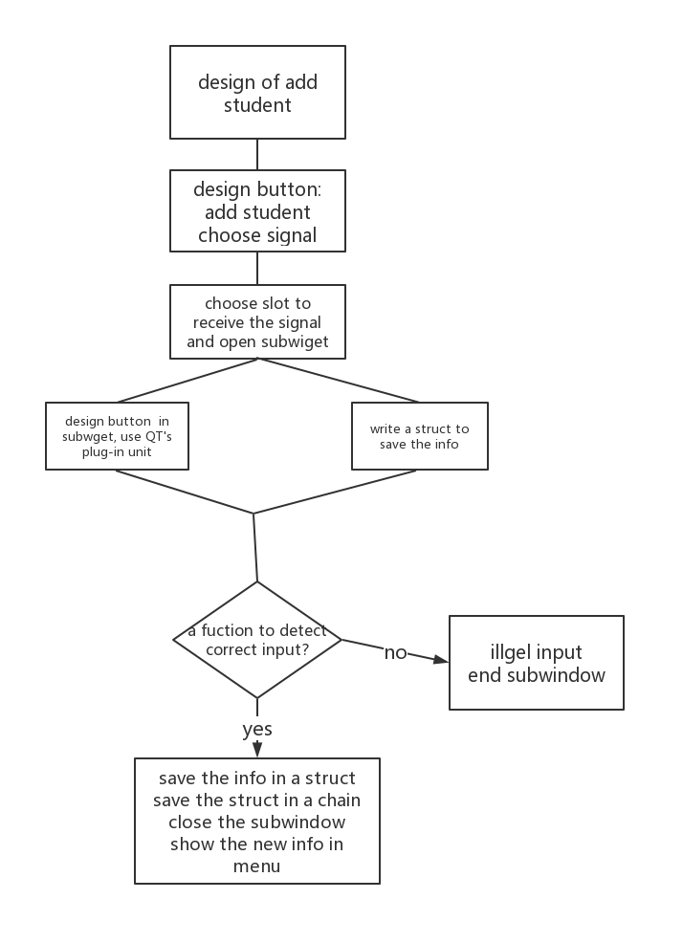
QT
Signal and slot is a basic partner in our interface design, especially in our button design. This flow chart can explicitly explain our design .
.

Slide 6
Algorithms
queque.h
int EnQueue(SqQueue que, int x){
if((que.rear + 1)%5 == que.front)
return 0;
que.data[que.rear] = x;
que.rear = (que.rear +1) %5;
return 1;
}

Slide 7
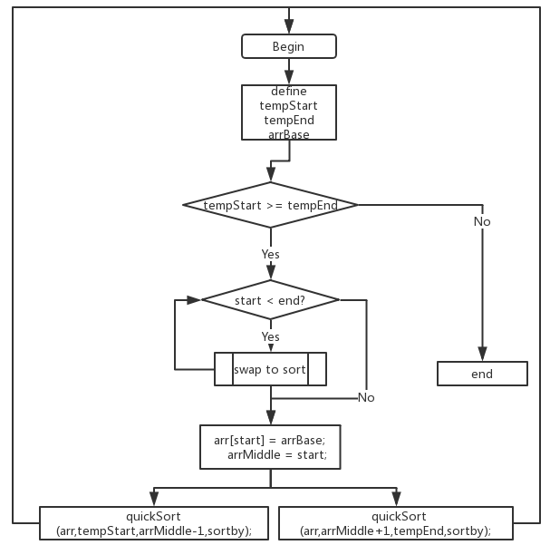
Algorithms
medicine.h
struct Med ;
int is_inc(struct Med a,struct Med b,
char sortby)
int is_dec(struct Med a,struct Med b,
char sortby)
void swap(struct Med *a, struct Med *b)
void quickSort(struct Med arr[] ,int start, int end,char sortby)
int extract(char type[],int tot)

Slide 8
Algorithms
medicine.h
struct Med ;
int is_inc(struct Med a,struct Med b,
char sortby)
int is_dec(struct Med a,struct Med b,
char sortby)
void swap(struct Med *a, struct Med *b)
void quickSort(struct Med arr[] ,int start, int end,char sortby)
int extract(char type[],int tot)

Slide 9
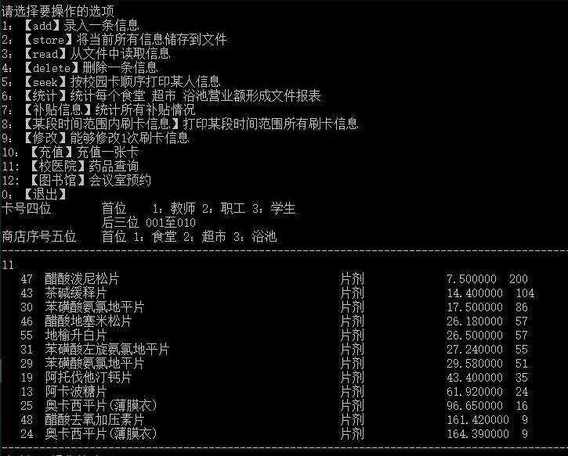
Test of quick sort

Slide 10
Interface test
1:log in
2: add shop
3: change shop’s information
4: add deal record
5: change deal record

Slide 11
THANKS!
Notes:
版权声明：400套精品模板商业授权，请联系【OMG99素材店】:https://omg99.taobao.com，专业PPT老师为你解决所有PPT问题！

